Slide 1
Introduction to Neo4j Graph Database
ANJU MUNOTH

Slide 2
What is a graph?

Slide 3
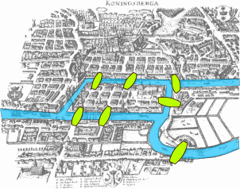
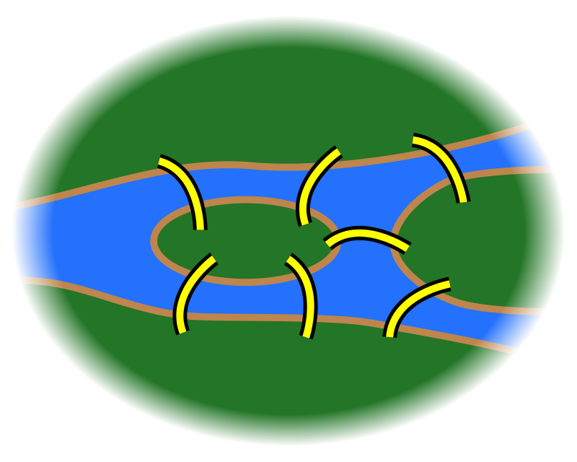
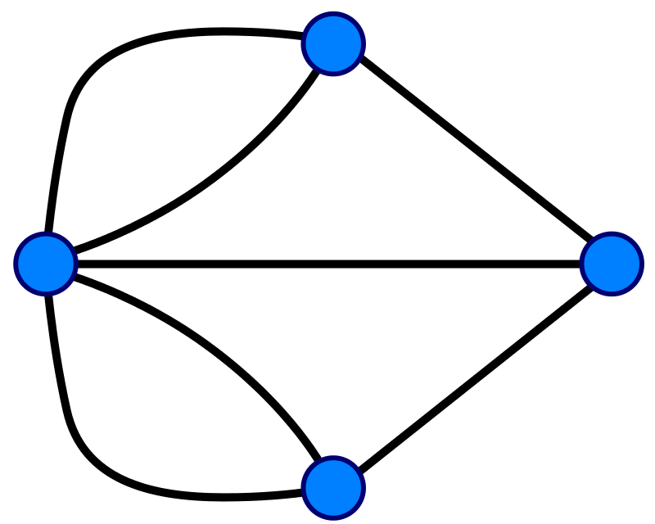
A graph is...
...a set of discrete objects, each of which has some set of relationships with the other objects
Seven Bridges of Konigsberg problem. Leonhard Euler, 1735

Slide 4
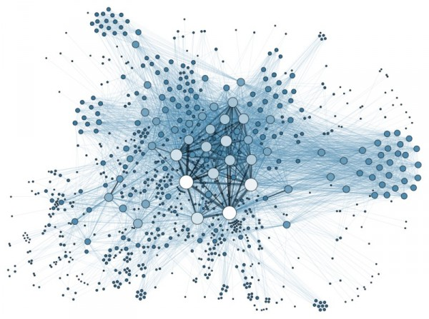
Anything can be a graph
the Internet
a water molecule
H
H
O

Slide 5
Why do we want graphs?

Slide 6
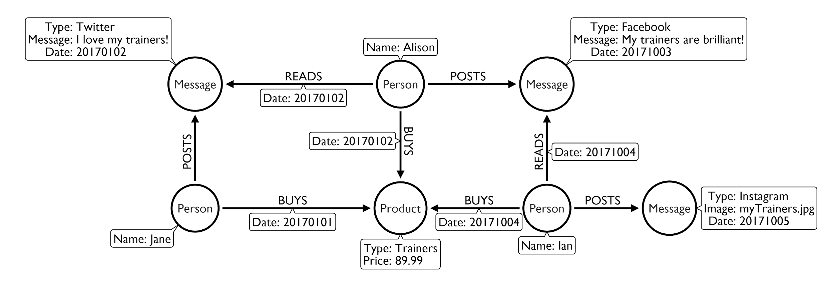

Slide 7
Panama papers:
simple model, powerful outcome

Slide 8
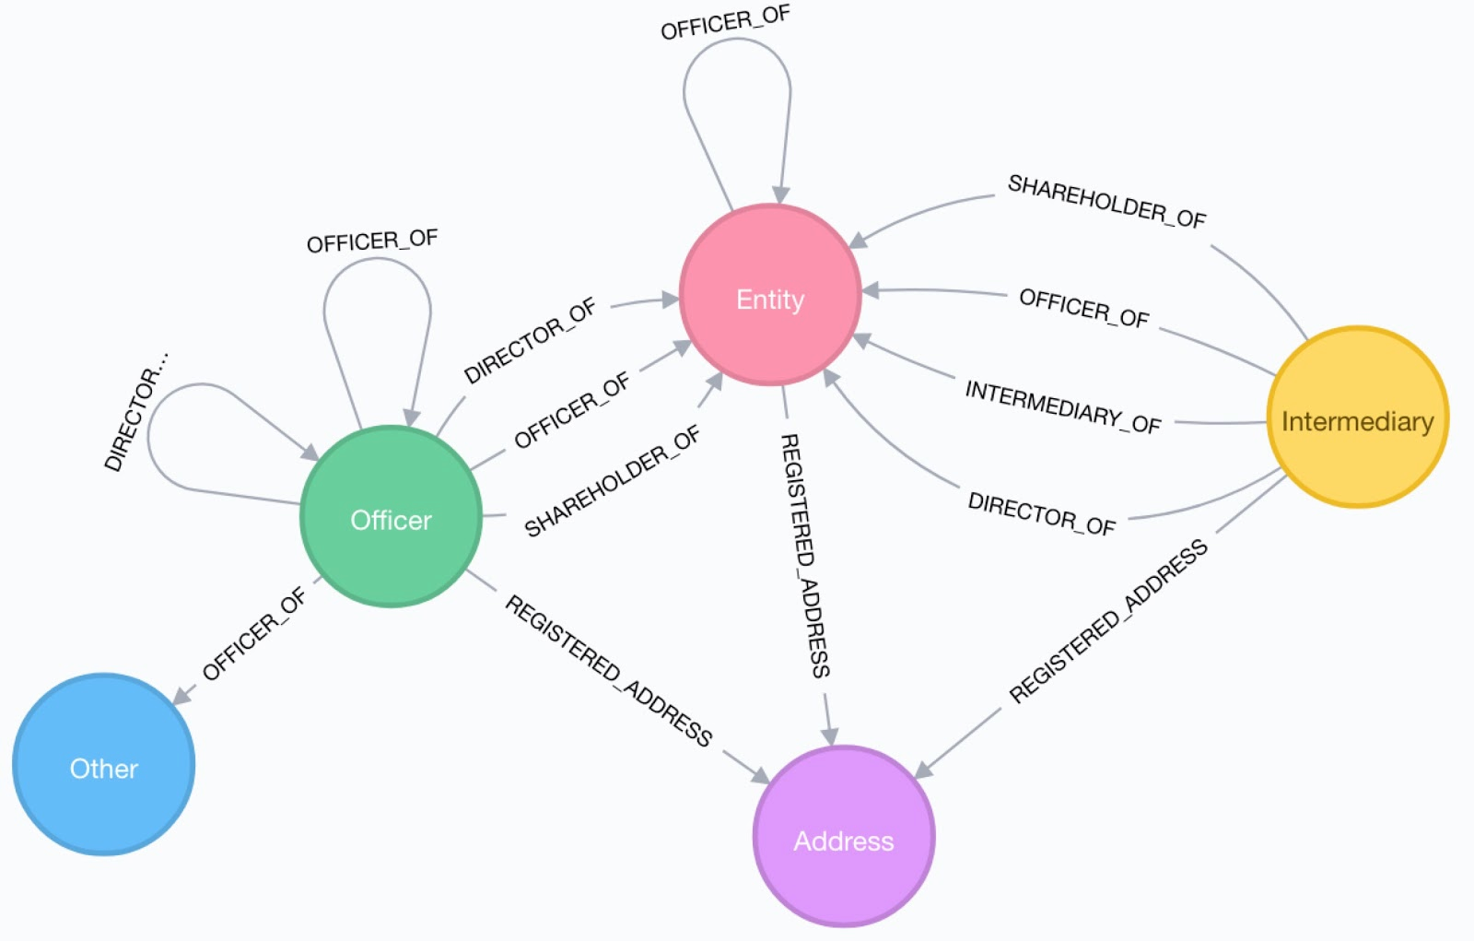
The Panama papers data model...

Slide 9
Roses are red,
facebook is blue,
No mutual friends,
So who are you?

Slide 10
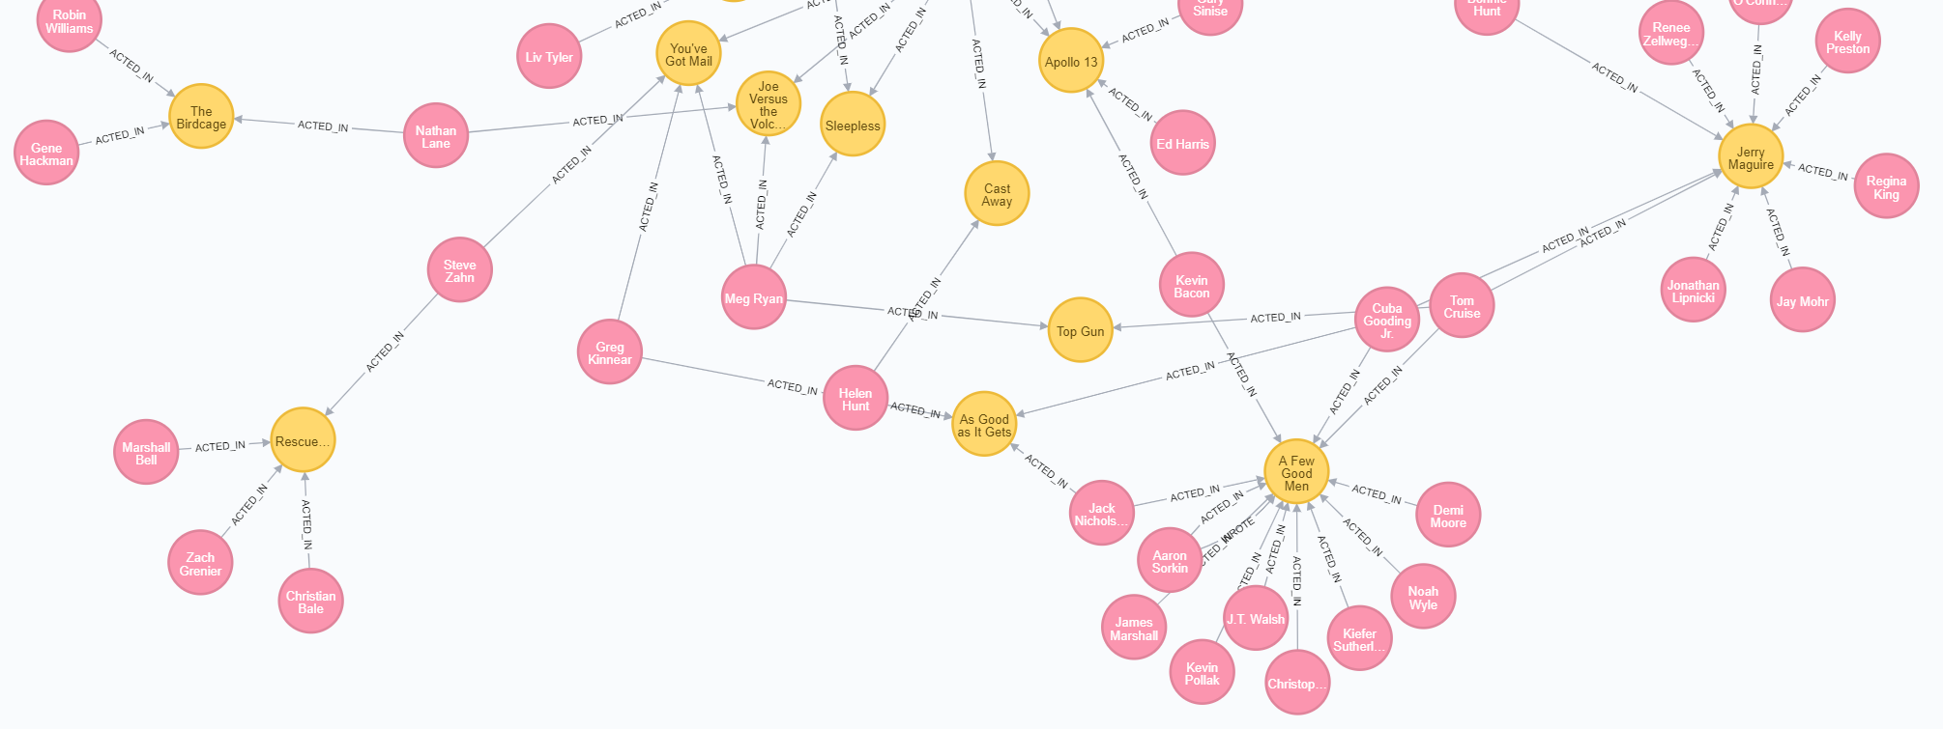
Friends of friends
...or co-actors of co-actors

Slide 11
What are good graph scenarios?

Slide 12
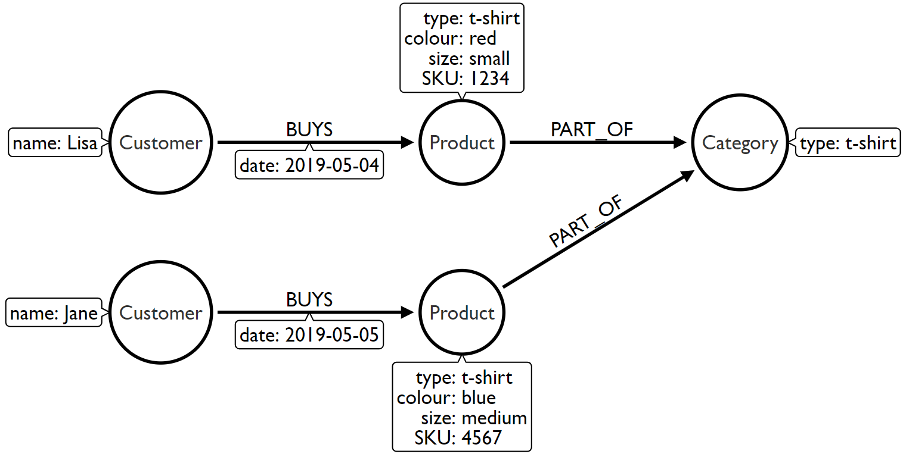
Identifying good graph scenarios
Scenario 1: Does our problem involve understanding relationships between entities?
Recommendations
Fraud detection
Finding duplicates
Data lineage

Slide 13
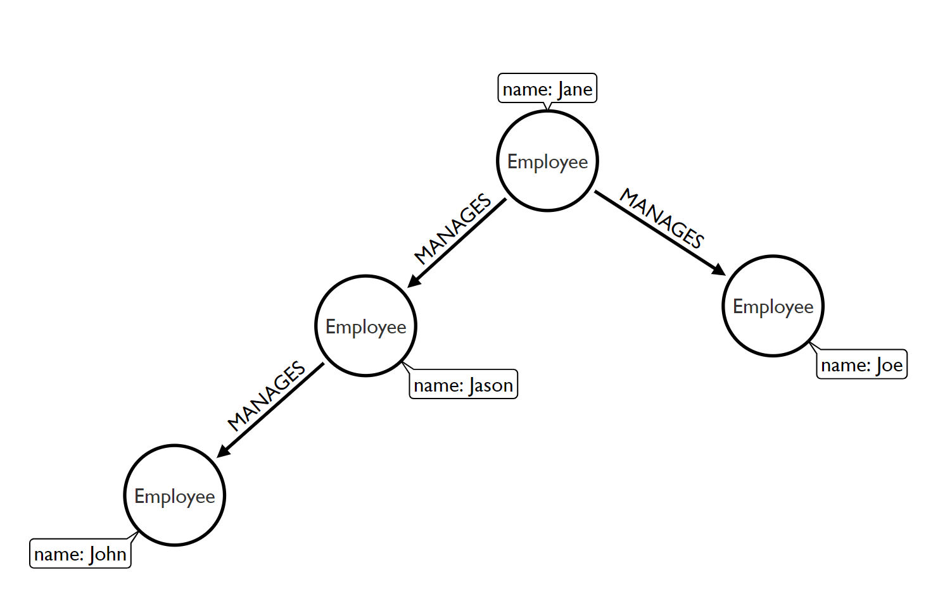
Identifying good graph scenarios
Scenario 2: Does the problem involve a lot of self-referencing to the same type of entity?
Organisational hierarchies
Access management
Social influencers
Friends of friends

Slide 14
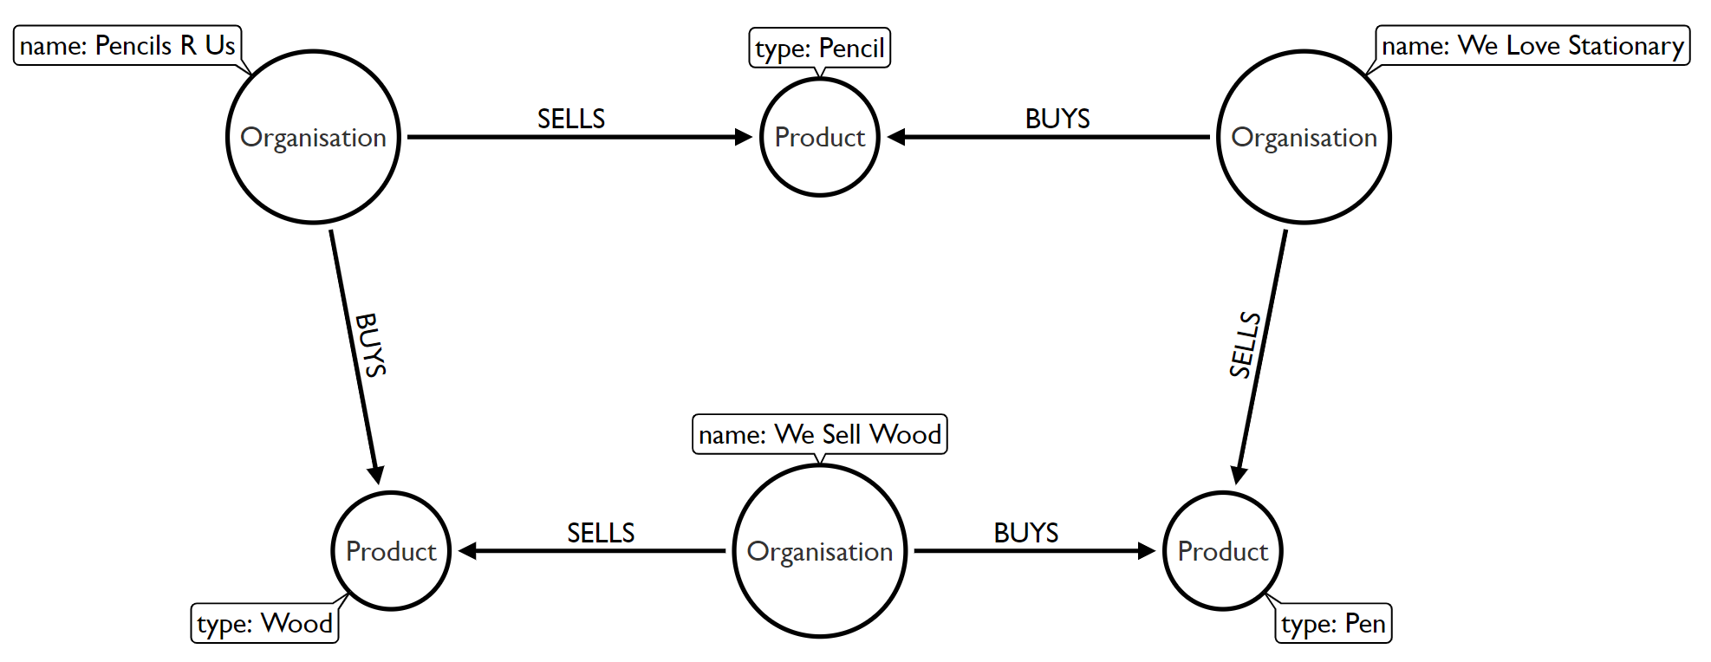
Identifying good graph scenarios
Scenario 3: Does the problem explore relationships of varying or unknown depth?
Supply chain visibility
Bill of Materials
Network management

Slide 15
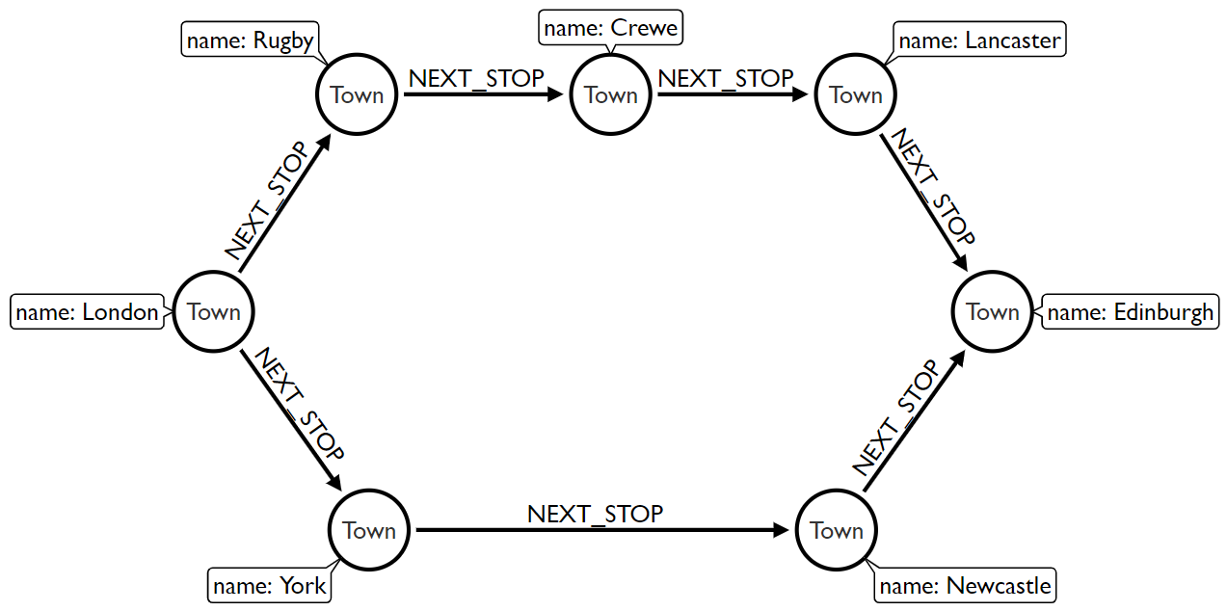
Identifying good graph scenarios
Scenario 4: Does our problem involve discovering lots of different routes or paths?
Logistics and routing
Infrastructure management
Dependency tracing

Slide 16
So what does a (property) graph look like?

Slide 17
Graph components
Node (Vertex)
The main data element from which graphs are constructed
Jane
car

Slide 18
Graph components
Node (Vertex)
The main data element from which graphs are constructed
Relationship (Edge)
A link between two nodes. Has:
Direction
Type
A node without relationships is permitted. A relationship without nodes is not
Jane
car
OWNS

Slide 19
Property graph database
Node (Vertex)
Relationship (Edge)
OWNS

Slide 20
Property graph database
Node (Vertex)
Relationship (Edge)
Label
Define node category (optional)
:Person
:Car
OWNS

Slide 21
Property graph database
Node (Vertex)
Relationship (Edge)
Label
Define node category (optional)
Can have more than one
:Person
:Car
:Asset
OWNS

Slide 22
Property graph database
Node (Vertex)
Relationship (Edge)
Label
Define node category (optional)
Can have more than one
:Person
:Car
:Asset
OWNS
since: 2018
Properties
Enrich a node or relationship
No need for nulls!
name: Jane
make: Volvo
model: V60

Slide 23
How do I query the graph?

Slide 24
Cypher
A pattern-matching query language made for graphs
24￼

Slide 25
Cypher
A pattern matching query language made for graphs
Declarative
Expressive
Pattern-Matching
25￼

Slide 26
Cypher
A pattern matching query language made for graphs
Declarative
Expressive
Pattern Matching
With ASCII ART ¯\_(ツ)_/¯
26￼

Slide 27
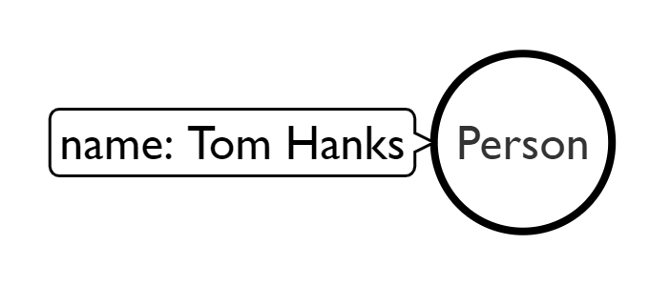
Use MATCH to retrieve nodes
//Match all nodes
MATCH (n)
RETURN n;

Slide 28
Use MATCH to retrieve nodes
//Match all nodes
MATCH (n)
RETURN n;
//Match all nodes with a Person label
MATCH (n:Person)
RETURN n;

Slide 29
Use MATCH to retrieve nodes
//Match all nodes
MATCH (n)
RETURN n;
//Match all nodes with a Person label
MATCH (n:Person)
RETURN n;
//Match all nodes with a Person label and property name is "Tom Hanks"
MATCH (n:Person {name: "Tom Hanks"})
RETURN n;

Slide 30
Use MATCH and properties to retrieve nodes
//Return nodes with label Person and name property is "Tom Hanks" - Inline
MATCH (p:Person {name: "Tom Hanks"}) //Only works with exact matches
RETURN p;

Slide 31
Use MATCH and properties to retrieve nodes
//Return nodes with label Person and name property is "Tom Hanks" - Inline
MATCH (p:Person {name: "Tom Hanks"}) //Only works with exact matches
RETURN p;
//Return nodes with label Person and name property equals "Tom Hanks"
MATCH (p:Person)
WHERE p.name = "Tom Hanks"
RETURN p;

Slide 32
Use MATCH and properties to retrieve nodes
//Return nodes with label Person and name property is "Tom Hanks" - Inline
MATCH (p:Person {name: "Tom Hanks"}) //Only works with exact matches
RETURN p;
//Return nodes with label Person and name property equals "Tom Hanks"
MATCH (p:Person)
WHERE p.name = "Tom Hanks"
RETURN p;
//Return nodes with label Movie, released property is between 1991 and 1999
MATCH (m:Movie)
WHERE m.released > 1990 AND m.released < 2000
RETURN m;

Slide 33
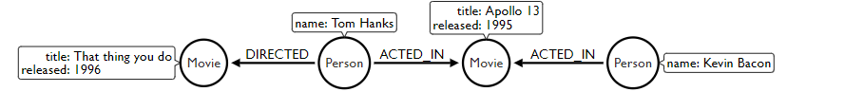
Extending the MATCH

Slide 34
Extending the MATCH
//Find all the movies Tom Hanks acted in
MATCH (:Person {name:"Tom Hanks"})-[:ACTED_IN]->(m:Movie)
RETURN m.title;

Slide 35
Extending the MATCH
//Find all the movies Tom Hanks acted in
MATCH (:Person {name:"Tom Hanks"})-[:ACTED_IN]->(m:Movie)
RETURN m.title;
//Find all the movies Tom Hanks directed and order by latest movie
MATCH (:Person {name:"Tom Hanks"})-[:DIRECTED]->(m:Movie)
RETURN m.title, m.released ORDER BY m.released DESC;

Slide 36
Extending the MATCH
//Find all the movies Tom Hanks acted in
MATCH (:Person {name:"Tom Hanks"})-[:ACTED_IN]->(m:Movie)
RETURN m.title;
//Find all the movies Tom Hanks directed and order by latest movie
MATCH (:Person {name:"Tom Hanks"})-[:DIRECTED]->(m:Movie)
RETURN m.title, m.released ORDER BY m.released DESC;
//Find all of the co-actors Tom Hanks have worked with
MATCH (:Person {name:"Tom Hanks"})-->(:Movie)<-[:ACTED_IN]-(coActor:Person)
RETURN coActor.name;

Slide 37
CREATE
//Create a person node called "Tom Hanks"
CREATE (p:Person {name:"Tom Hanks"});

Slide 38
CREATE
//Create a person node called "Tom Hanks"
CREATE (p:Person {name:"Tom Hanks"});
//Create an ACTED_IN relationship between "Tom Hanks" and "Apollo 13"
MATCH (p:Person {name:"Tom Hanks"}), (m:Movie {title:"Apollo 13"})
CREATE (p)-[:ACTED_IN]->(m);

Slide 39
CREATE
//Create a person node called "Tom Hanks"
CREATE (p:Person {name:"Tom Hanks"});
//Create an ACTED_IN relationship between "Tom Hanks" and "Apollo 13"
MATCH (p:Person {name:"Tom Hanks"}), (m:Movie {title:"Apollo 13"})
CREATE (p)-[:ACTED_IN]->(m);
//Create the pattern of "Tom Hanks" ACTED_IN "Apollo 13"
//This will create the entire pattern, nodes and all!
CREATE (:Person {name:"Tom Hanks")-[:ACTED_IN]->(:Movie {title:"Apollo 13});

